Slide 1
ME - 766 Course Project
Parallelization of A* algorithm
Rachit Adlakha
Amandeep Singh
Saurabh Khandelwal
Saksham Gautam

Slide 2
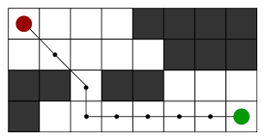
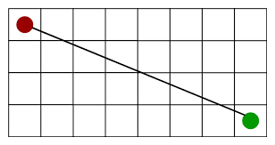
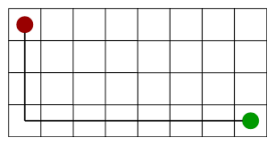
A* Algorithm
A* Algorithm is one of the best technique used for path finding and graph transversals. A lot of games and web-based maps use this algorithm to find the shortest path efficiently. It is essentially a best first search algorithm.
Shortest path
Slightly long path
A* Algorithm extends the path that minimizes the following function-
f(n) = g(n) + h(n)
Where,
‘n’ is the last node on the path
g(n) is the cost of the path from start node to node ‘n’
h(n) is a heuristic function that estimates cost of the cheapest path from node ‘n’ to the goal node

Slide 3
Implementing A* Algorithm
The implementation of A* Algorithm involves maintaining two lists - OPEN and CLOSED.
OPEN contains nodes that have evaluated by heuristic function but have not expanded to successors.
CLOSED contains nodes that have already been visited.
The Algorithm works as following steps:
Step 1: Define a list OPEN, initially this consists solely of a single node, the start node S
Step 2: If the list is empty, return failure and exit
Step 3: Remove node n with the smallest value of f(n) from OPEN and move it to list CLOSED. If node n is a goal state, return success and exit
Step 4: Expand node n
Step 5: If any successor to n is the goal node, return success and the solution by tracing the path from goal node to S. Otherwise, go to Step 6
Step 6: For each successor node, Apply the evaluation function f to the node. If the node has not been in either list, add it to OPEN
Step 7: Go back to Step 2

Slide 4
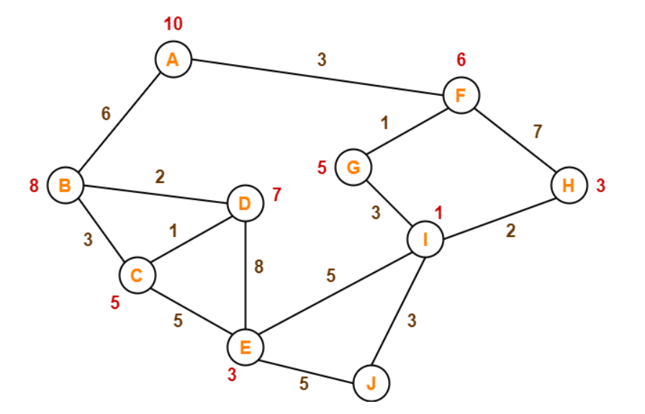
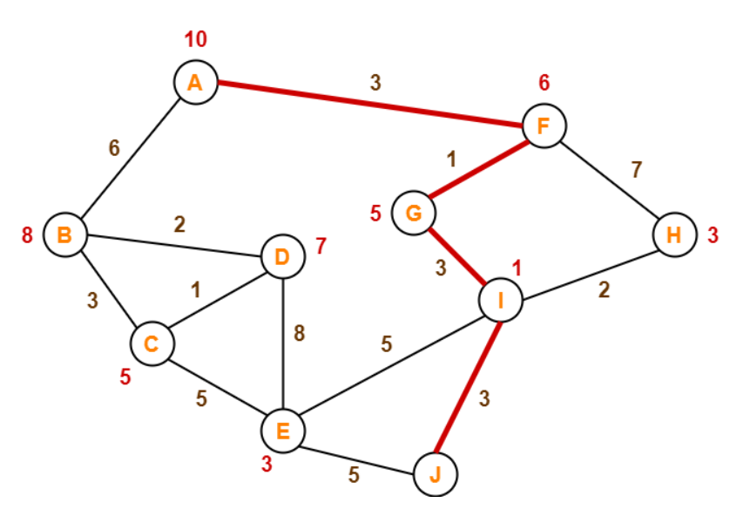
A* Algorithm - Illustrative Example
Starting from node A:
f(B) = 6 + 8 = 14
f(F) = 3 + 6 = 9
Hence we go with node F
Path: A - F
From F:
f(G) = (3 + 1) + 5 = 9
f(H) = (3 + 7) + 3 = 13
Hence we go with G
Path: A - F - G
From G:
f(I) = (3 + 1 + 3) + 1 = 8
Hence we go with I
Path: A - F - G - I
From I:
f(E) = (3 + 1 + 3 + 5) + 3 = 15
f(H) = (3 + 1 + 3 + 2) + 3 = 12
f(J) = (3 + 1 + 3 + 3) + 0 = 10
Since J is our destination, so required shortest path is {A - F - G - I - J}

Slide 5
Hash Distributed A*
Hash Distributed A* - Particularly a parallelization technique of A*
Straightforward implementation of a hash based work distribution scheme on a shared memory machine
A concurrent queue is used to hold nodes. This queue is accessible by all the threads
Each processing thread owns a local open/closed list which is implemented in shared memory
When a state is assigned to some thread, the writer thread obtains a lock on the target shared memory (concurrent queue), writes the state, then releases the lock.

Slide 6
Implementation of Hash Distributed A*
The overall HDA* algorithm begins by the expansion of the start state at the head processor. Each processor P undergoes through a certain loop until an optimal solution is found:
Firstly, the processor P checks if a new state has been received in its message queue. If so, P checks for this new state S in P’s closed list.
If the message queue is empty, then P selects a highest priority state from its local open list and expands it, resulting in newly generated states.
For each of the newly generated states Si, a hash key K(Si) is computed based on the state representation, and the generated state is then sent to the processor which owns K(Si). This send is asynchronous and non-blocking.
P continues its computation without waiting for a reply from the destination

Slide 7
Results - Tabular Representation
Matrix Size (N*N) | Time (in ms)
 | Sequential | HDA1 | HDA2 | HDA4 | HDA8
3 | 13 | 7.67 | 0 | 0 | 16
50 | 8.33 | 8.67 | 6.67 | 5.67 | 57
100 | 48 | 47.33 | 2967 | 29 | 1515
200 | 222 | 149.67 | 89.33 | 112.33 | 439.33
500 | 1003 | 1001.67 | 629.67 | 598 | 3510.33
1000 | 4610.67 | 4480 | 2694 | 2007.67 | 16587
2000 | 14671 | 14255.67 | 7987.33 | 6882 | 79206.67

Slide 8
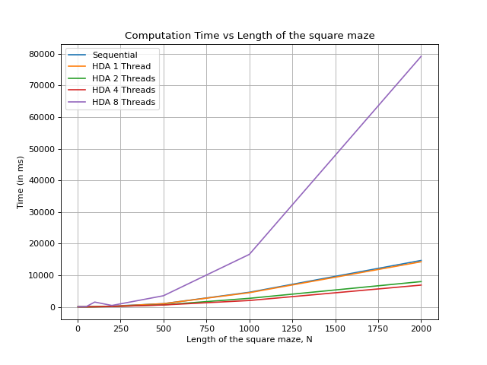
Results - Graphical Representation

Slide 9
Conclusions
Hash Distributed A* (HDA) performed better than the sequential A* (except for HDA with 8 thread)
HDA with 1, 2 and 4 threads showed significant improvement in computation time.
HDA with 4 threads performed the best along all input matrix sizes.

Slide 10
Contributions
Code - Saurabh, Rachit, Amandeep
Input data for testing - Rachit, Saurabh
Result analysis - Rachit, Saurabh
PPT - Saksham, Amandeep
Report - Saksham, Amandeep
References
https://www.semanticscholar.org/paper/Scalable%2C-Parallel-Best-First-Search-for-Optimal-Kishimoto-Fukunaga/a83b45a5923a2cb89b6d22b736845187ce4966f4
https://www.threadingbuildingblocks.org/docs/help/reference/containers_overview/concurrent_queue_cls.html

